Slide 1
Our Forever Friend
Hockliffe Street Baptist Church
10 February 2019

Slide 2
Our Forever Friend
A New Relationship
A Near Relationship
A Never-Ending Relationship

Slide 3
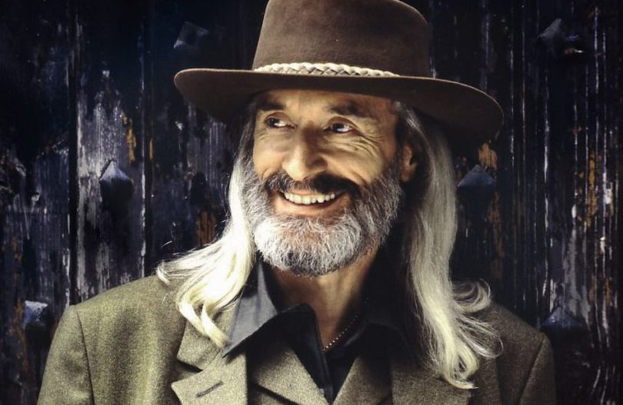
Our Forever Friend

Slide 4
Our Forever Friend

Slide 5
Our Forever Friend
A New Relationship
A Near Relationship
A Never-Ending Relationship

Slide 6
Our Forever Friend
“We are lonely but fearful of intimacy.
Digital connections may offer the illusion of companionship without the demands of friendship.
Our networked life allows us to hide from each other, even as we are tethered to each other.”

Slide 7
Our Forever Friend
A New Relationship
A Near Relationship
A Never-Ending Relationship

Slide 8
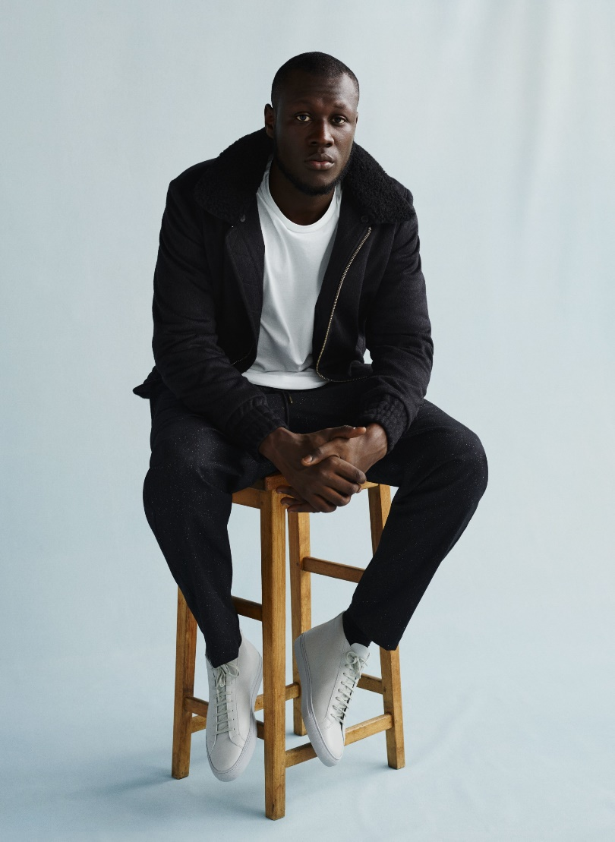
Our Forever Friend
I'm blinded by your grace
Through the darkness you came
And I'll be alright
With you by my side
I can't escape you
I can't replace you
So don't walk away from me now
(Stormzy)

Slide 9
Our Forever Friend
“It was like when a man, after a long sleep, still lying motionless in bed, becomes aware that he is now awake.”

Slide 10
Our Forever Friend
A reorientation of the whole person

Slide 11
Our Forever Friend
A New Relationship
A Near Relationship
A Never-Ending Relationship

Slide 12
Our Forever Friend
A New Relationship
A Near Relationship
A Never-Ending Relationship

Slide 13
Our Forever Friend
I know not what of good or ill
May be reserved for me,
Of weary ways or golden days,
Before His face I see.

Slide 14
Our Forever Friend
But “I know Whom I have believed
And am persuaded that He is able
To keep that which I’ve committed
Unto Him against that day.”

Slide 15
As the Father has loved me, so have I loved you. Now remain in my love. If you keep my commands, you will remain in my love, just as I have kept my Father’s commands and remain in his love. I have told you this so that my joy may be in you and that your joy may be complete. My command is this: Love each other as I have loved you. Greater love has no one than this: to lay down one’s life for one’s friends. You are my friends if you do what I command. I no longer call you servants, because a servant does not know his master’s business. Instead, I have called you friends, for everything that I learned from my Father I have made known to you. You did not choose me, but I chose you and appointed you so that you might go and bear fruit—fruit that will last—and so that whatever you ask in my name the Father will give you. This is my command: Love each other.

Slide 16
Our Forever Friend We don’t yet see things clearly. We’re squinting in a fog, peering through a mist. But it won’t be long before the weather clears and the sun shines bright! We’ll see it all then, see it all as clearly as God sees us, knowing him directly just as he knows us! But for right now, until that completeness, we have three things to do to lead us toward that consummation: Trust steadily in God, hope unswervingly, love extravagantly. And the best of the three is love. (1 Corinthians 13:12-13, The Message)

Slide 17
Our Forever Friend

